Slide 1

LOAN APPROVAL SYSTEM

Slide 2

DATA SET INFORMATION

Slide 3
OBJECTIVE:
TO BUILD A MODEL TO PREDICT DEFAULT IN THE FUTURE TO HELP THE COMPANY IN DECIDING WHETHER OR NOT TO PASS THE LOAN.
Y VARIABLE: default_ind

Slide 4
EXPLARATORY DATA ANALYSIS (EDA)

Slide 5
A. MISSING VALUES INFORMATION
COLUMN NAME | NO OF MISSING VALUES |  | COLUMN NAME | NO OF MISSING VALUES
emp_title | 49447 |  | tot_cur_bal | 67313
emp_length | 43061 |  | open_acc_6m | 842681
desc | 734157 |  | open_il_6m | 842681
title | 33 |  | open_il_12m | 842681
mths_since_last_delinq | 439812 |  | open_il_24m | 842681
mths_since_last_record | 724785 |  | mths_since_rcnt_il | 843035
last_pymnt_d | 8862 |  | total_bal_il | 842681
next_pymnt_d | 252971 |  | il_util | 844360
last_credit_pull_d | 50 |  | open_rv_12m | 842681
collections_12_mths_ex_med | 56 |  | open_rv_24m | 842681
mths_since_last_major_derog | 642830 |  | max_bal_bc | 842681
annual_inc_joint | 855527 |  | all_util | 842681
dti_joint | 855529 |  | total_rev_hi_lim | 67313
verification_status_joint | 855527 |  | inq_fi | 842681
tot_coll_amt | 67313 |  | total_cu_tl | 842681
 |  |  | inq_last_12m | 842681

Slide 6
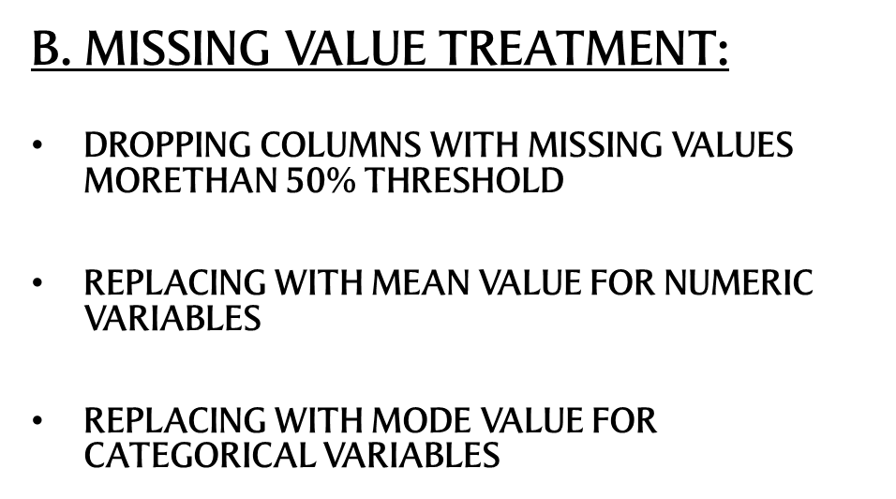

Slide 7
C. VARIABLE SELECTION
DROPPING COLUMNS WHICH ARE NOT SIGNIFICANT
OUTLIER :
BADRATE:
FEATURE SELECTION

Slide 8
D. DATA CONVERSION
1. LABEL ENCODER :
To convert categorical text data into model-understandable numerical data
It will create levels and populate the dictionary
Then it will map those levels in to variables
2. CONVERTING ISSUE_D TO DATA TYPE=DATETIME
EDA CONCLUSION
LEFT WITH 41 VARIABLES AFTER DROPPING AND TREATMENT

Slide 9
DATA PARTITION
DATA PARTITION IS DONE ON THE BASIS OF issued VARIABLE
TRAINING DATA: JUNE 2007 - MAY 2015 (598978,40)
TESTING DATA: JUNE 2015 - DEC 2015 (256991, 40)
REMOVING ISSUE_D SINCE WE DO NOT NEED IT

Slide 10
CREATING X,Y VARIABLES
TRAINING DATASET:
X_TRAIN
Y_TRAIN
TESTING DATASET
X_TEST
Y_TEST

Slide 11
ALGORITHMS USED:
LOGISTIC REGRESSION
DECISION TREE
ENSEMBLE MODELLING
RANDOM FOREST CLASSIFICATION
GRADIENT BOOSTING

Slide 12
STEP 11 # IMPLEMENTING LOGISTIC REGRESSION
from sklearn.linear_model import Logistic Regression
#CREATE A MODEL
classifier=LogisticRegression()
#FITTING TRAINING DATA TO THE MODEL
classifier.fit(X_train,Y_train)
#PREDICTION ON TRAINING DATA
Y_pred=classifier.predict(X_test)
print(list(zip(Y_test,Y_pred)))

Slide 13
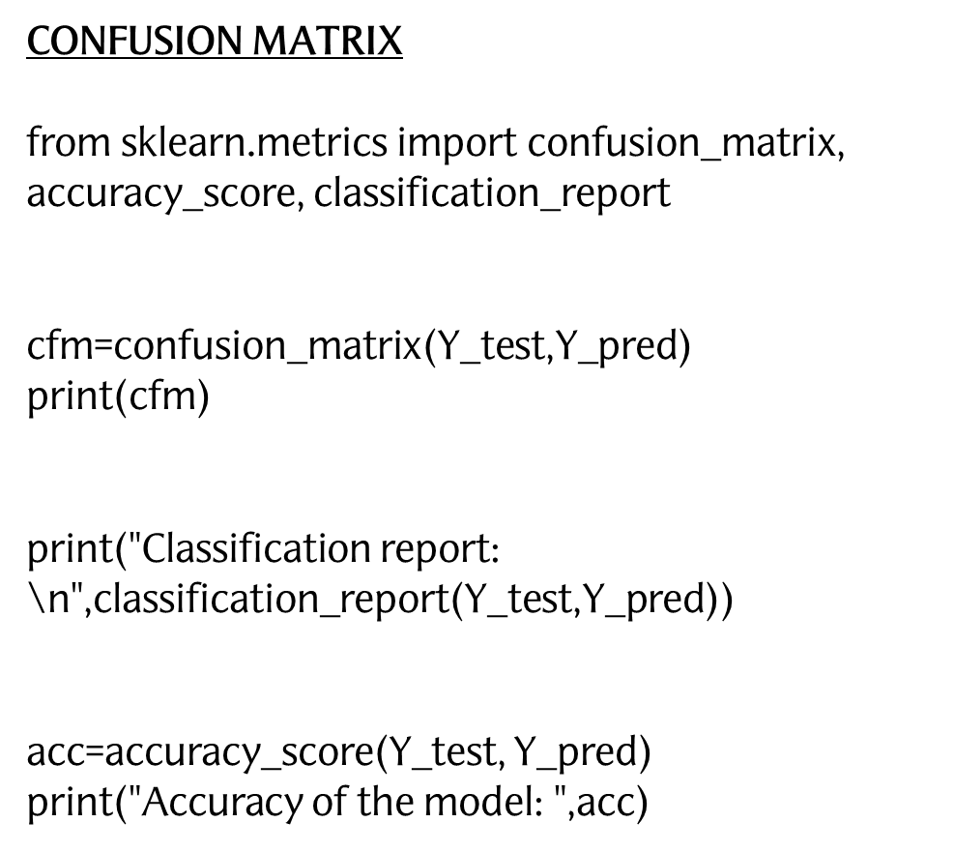

Slide 14
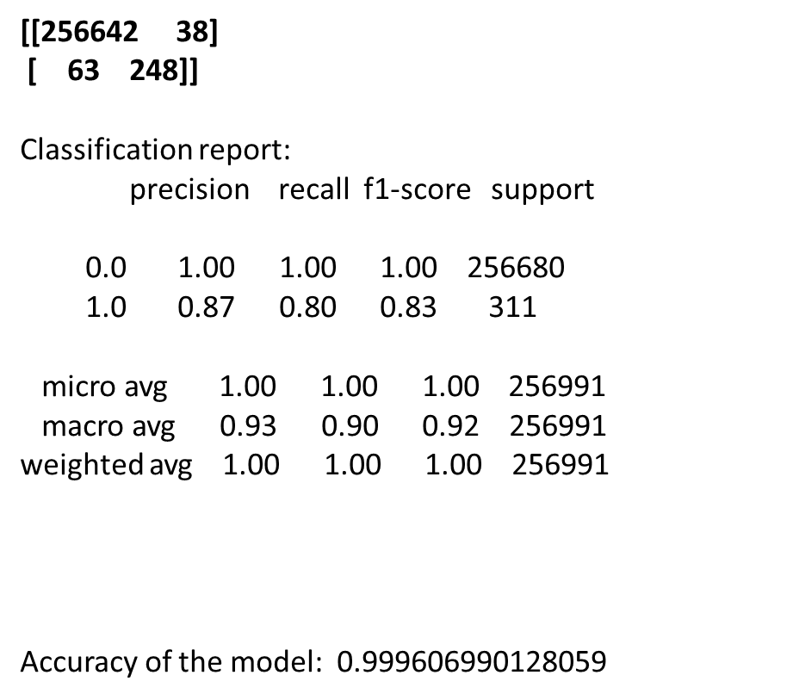

Slide 15
STEP 15 ## FEATURE SELECTION USING RECURSIVE FEATURE ELIMINATION (RFE)
from sklearn.feature_selection import RFE
#CREATE A MODEL
rfe = RFE(classifier, 30)
#FITTING TRAINING DATA TO THE MODEL
model_rfe = rfe.fit(X_train, Y_train)
print("Num Features: ",model_rfe.n_features_)
print("Selected Features: ")
print(list(zip(loan_train.columns, model_rfe.support_)))
print("Feature Ranking: ", model_rfe.ranking_)
#PREDICTION ON TRAINING DATA
Y_pred=model_rfe.predict(X_test)

Slide 16
Num Features: 30
Selected Features:
[('loan_amnt', False), ('funded_amnt', True), ('funded_amnt_inv', True), ('term', False), ('int_rate', True), ('installment', True), ('grade', False), ('sub_grade', True), ('emp_length', True), ('home_ownership', True), ('annual_inc', False), ('verification_status', True), ('pymnt_plan', False), ('purpose', True), ('dti', True), ('delinq_2yrs', True), ('earliest_cr_line', True), ('inq_last_6mths', False), ('open_acc', True), ('pub_rec', True), ('revol_bal', False), ('revol_util', True), ('total_acc', True), ('initial_list_status', True), ('out_prncp', True), ('out_prncp_inv', True), ('total_pymnt', True), ('total_pymnt_inv', True), ('total_rec_prncp', True), ('total_rec_int', True), ('total_rec_late_fee', True), ('recoveries', True), ('collection_recovery_fee', True), ('last_pymnt_d', True), ('last_pymnt_amnt', True), ('last_credit_pull_d', True), ('collections_12_mths_ex_med', False), ('policy_code', True), ('application_type', False), ('acc_now_delinq', False), ('tot_coll_amt', False), ('tot_cur_bal', False), ('total_rev_hi_lim', False)]
Feature Ranking:
[ 8 1 1 3 1 1 2 1 1 1 10 1 13 1 1 1 1 7 1 1 5 1 1 1
1 1 1 1 1 1 1 1 1 1 1 9 1 14 11 4 12 6]

Slide 17
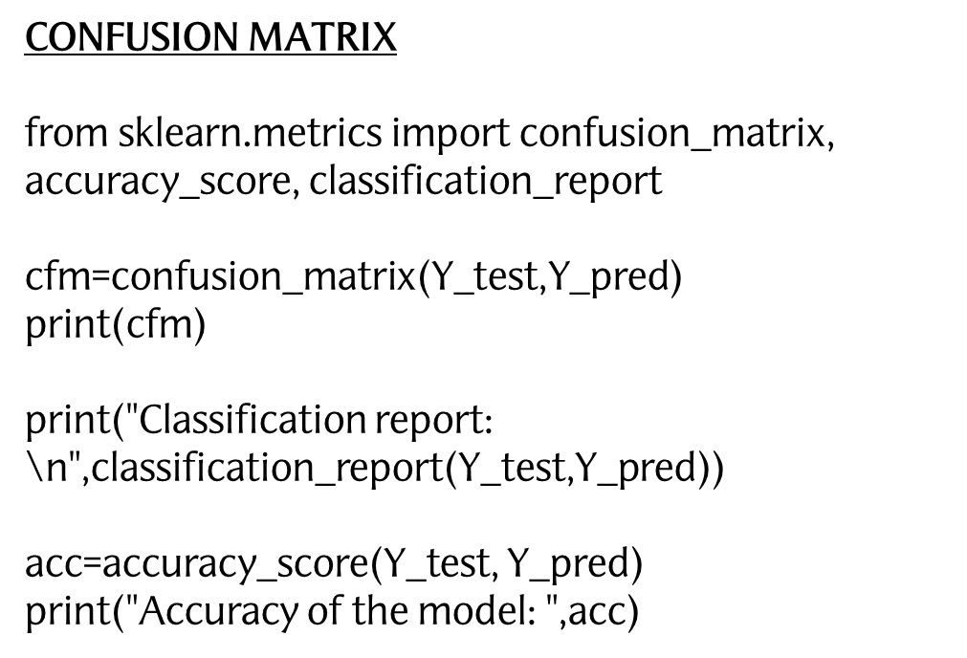

Slide 18
[[256641 39]
[ 63 248]]
Classification report:
precision recall f1-score support
0.0 1.00 1.00 1.00 256680
1.0 0.86 0.80 0.83 311
micro avg 1.00 1.00 1.00 256991
macro avg 0.93 0.90 0.91 256991
weighted avg 1.00 1.00 1.00 256991
Accuracy of the model: 0.999603098941208

Slide 19
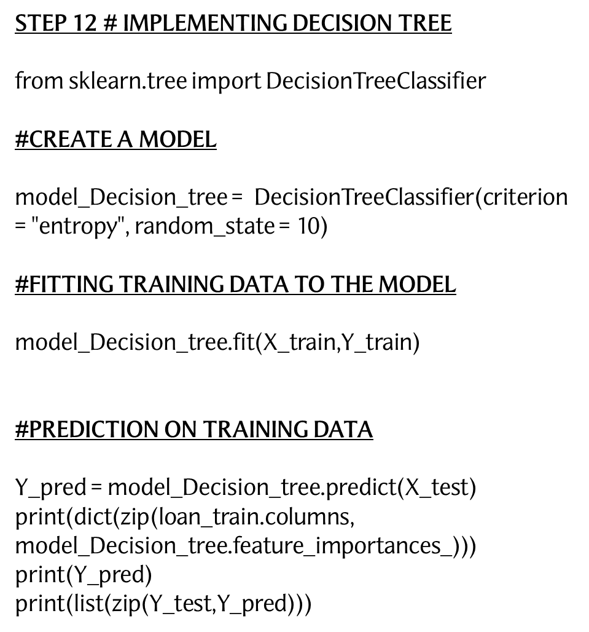

Slide 20
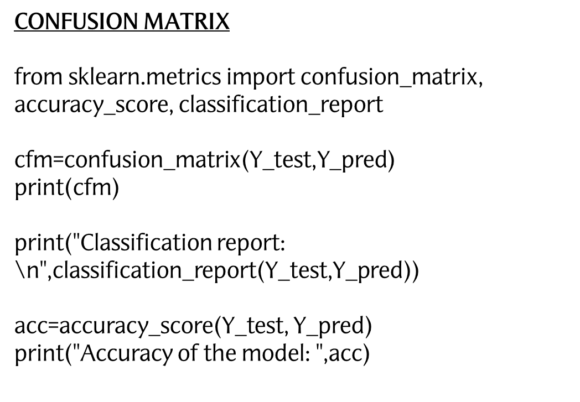

Slide 21
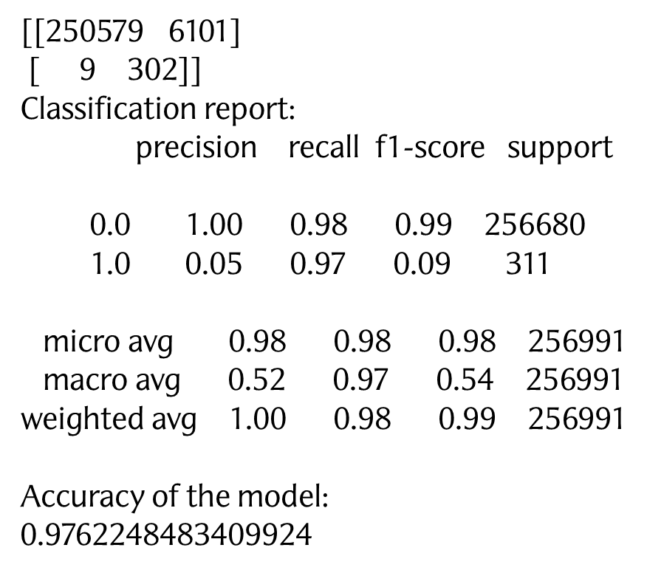

Slide 22
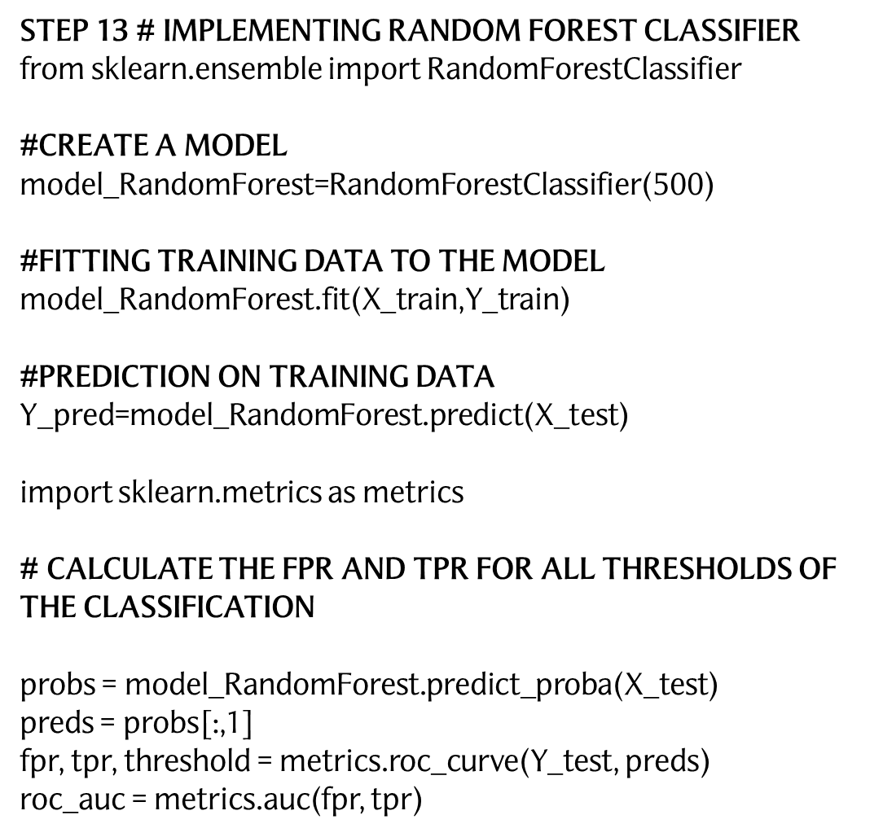

Slide 23
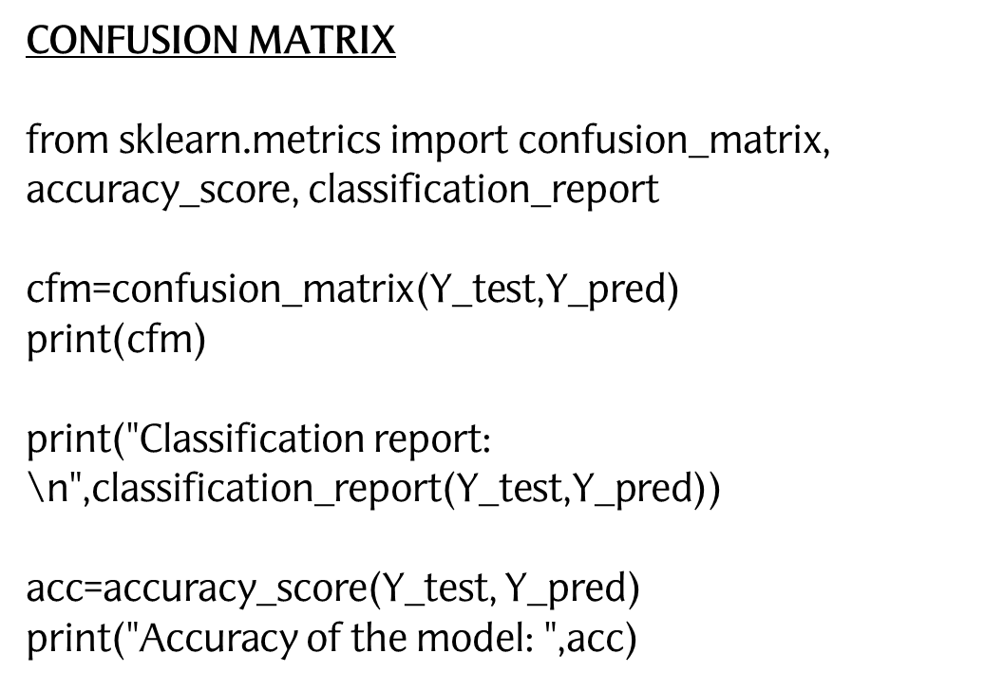

Slide 24
[[175715 80965]
[ 1 310]]
precision recall f1-score support
0.0 1.00 0.68 0.81 256680
1.0 0.00 1.00 0.01 311
micro avg 0.68 0.68 0.68 256991
macro avg 0.50 0.84 0.41 256991
weighted avg 1.00 0.68 0.81 256991

Slide 25
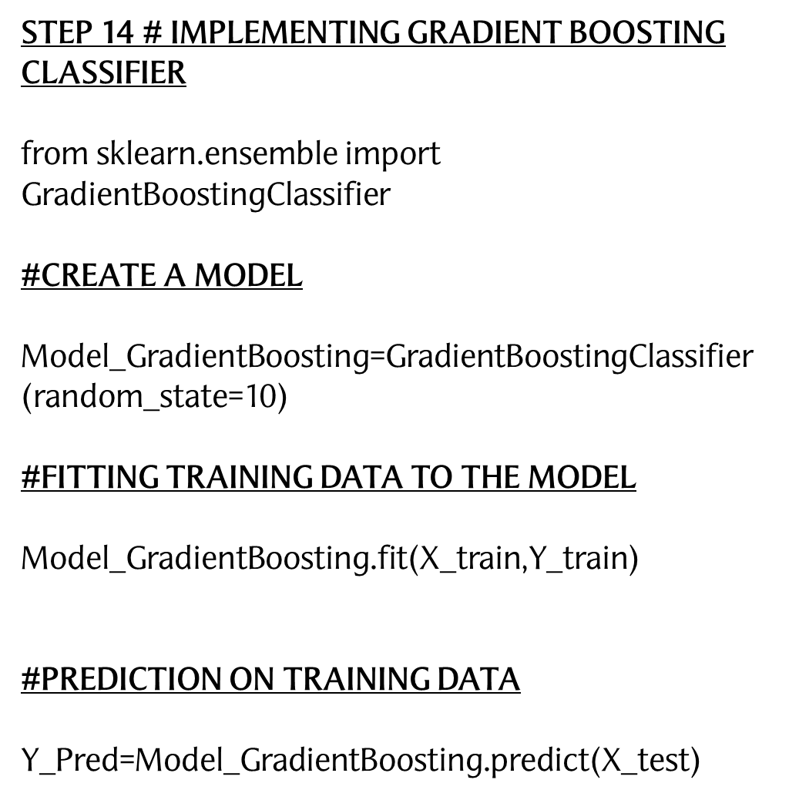

Slide 26
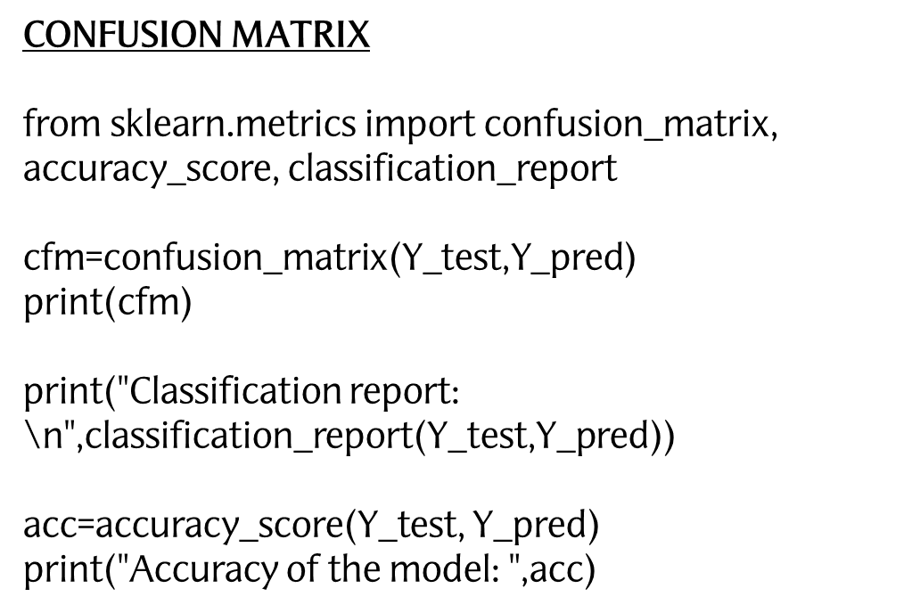

Slide 27
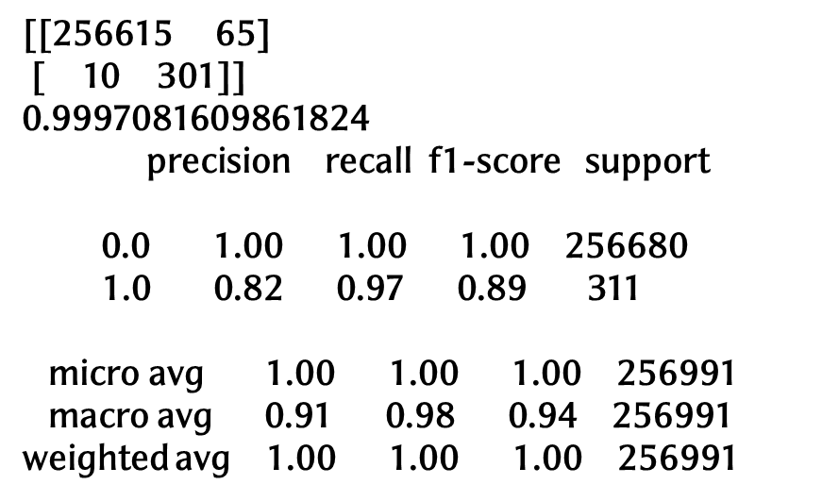

Slide 28
ALGORITHMS USED | TOTAL ERROR | TYPE 1 ERROR | TYPE 2 ERROR | ACCURACY
LOGISTIC REGRESSION | 101 | 38 | 63 | 99.96%
DECISION TREE | 6110 | 6101 | 9 | 97.6
RANDOM FOREST | 80966 | 80965 | 1 | 68.49%
GRADIENT BOOSTING | 75 | 65 | 10 | 99.97%

Slide 29
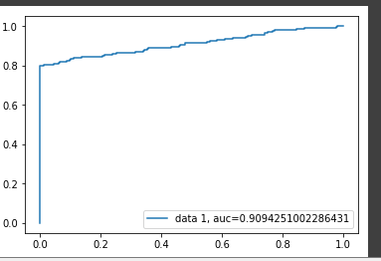
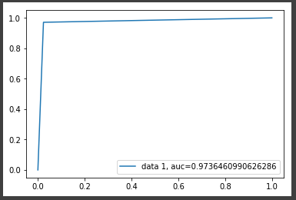
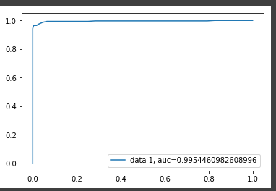
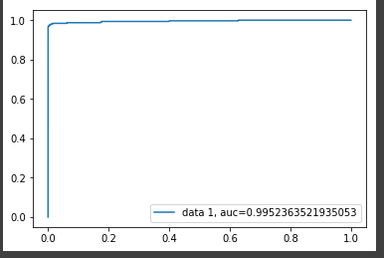
ROC CURVE
Logistics Regression
Decision Tree
Random Forest
Gradient Boosting

Slide 30
CONCLUSION
AFTER APPLYING ALL THE ALGORITHIMS AND THEN COMARING
AND ANALYZING THE ROC CURVE WE CONCLUDE THAT
GRADIENT BOOSTING HAS GIVEN US A BETER OUTPUT WITH
MINIMAL TYPE 1 AND TYPE 2 ERRORS

Slide 31
Thank You

